Slide 1
Improve Quality of Image by Utilizing LMS Algorithm
Presenter : 蕭弈均 2019.6.19

Slide 2
Outline
Antenna array & its pattern
Image
Parameter of LMS Algorithm
Demonstration

Slide 3
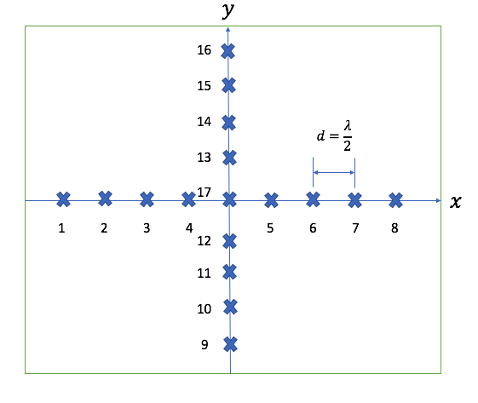
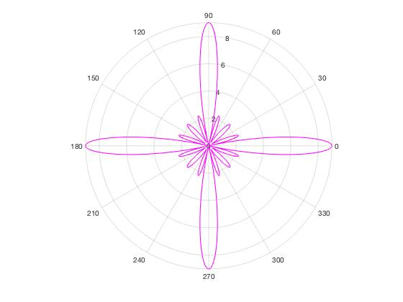
Antenna array & its pattern

Slide 4
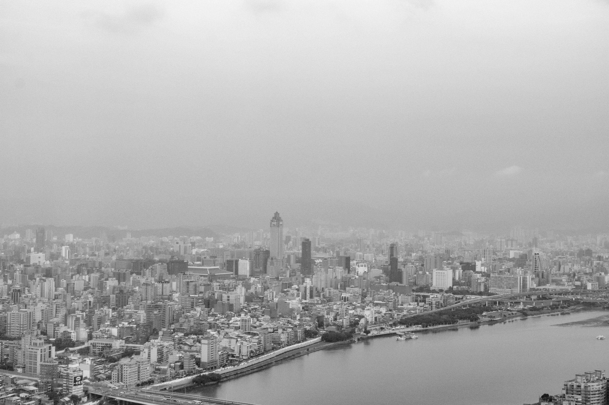
Image
Pixel : 500*750
Taipei city, a photo I took in the airplane.

Slide 5
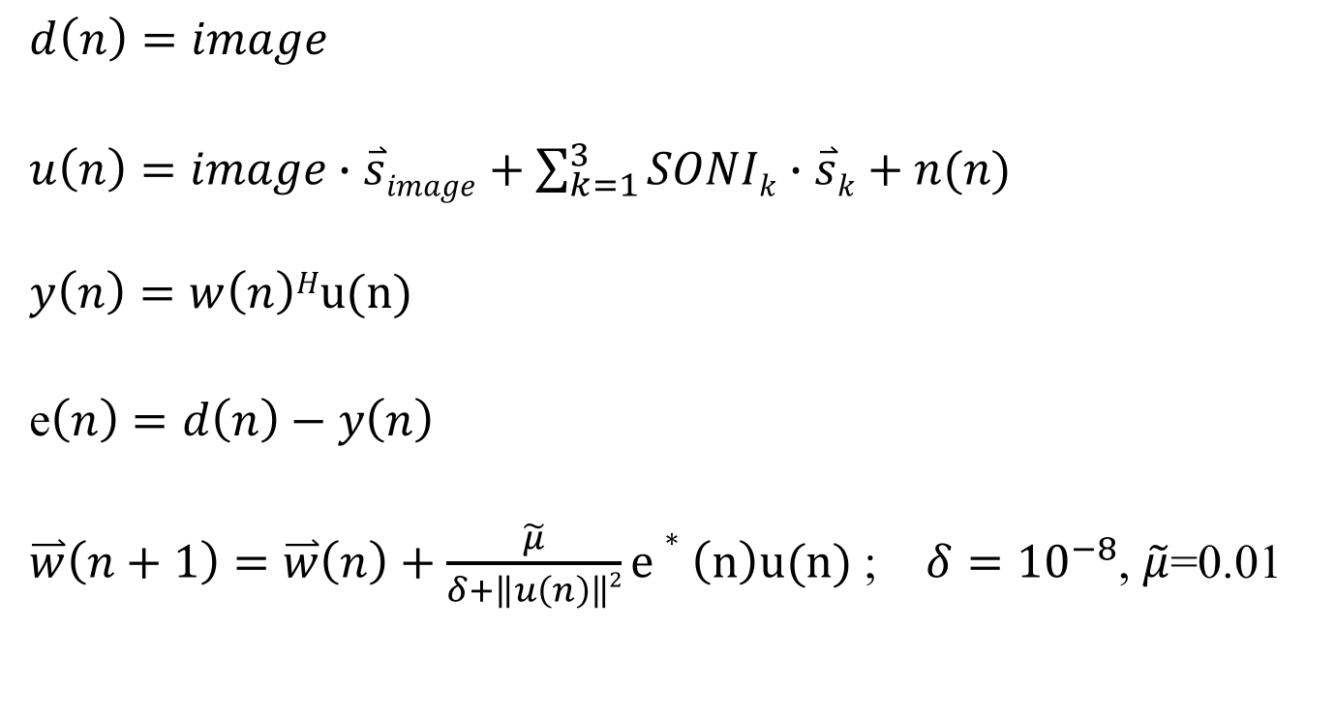
Parameter of LMS Algorithm
$$d\left(n\right)=image$$
$u\left(n\right)=image∙\overset{⃑}{s}image+\sum_{k=1}^{3}{SONIk}∙$ $\overset{⃑}{s}k+n(n)$
$$y\left(n\right)=w\left(n\right)Hu(n)$$
e$\left(n\right)=d\left(n\right)−y\left(n\right)$
$\overset{⃑}{w}\left(n+1\right)=\overset{⃑}{w}\left(n\right)+\frac{\tilde{μ}}{δ+\left\|u\left(n\right)\right\|2}e∗\left(n\right)u(n)$ ; $δ={10}^{−8}$, $\tilde{μ}$=0.01

Slide 6

Parameter of LMS Algorithm
Time of update will be large.
Therefore, I setting a threshold to stop updating.
$$if SINR>η=0.7 :$$
$stop algorithm.$

Slide 7
Demonstration

Slide 8
Thank you for your listening.

